Slide 1
Blackwell Electronics eCommerce Report
Team Charlie
Sarah Coyle | Marko Gorenc | Liliana Lopez | Shishir Patel | Deepa Ranjith

Slide 2
Executive Summary
To utilize customer transaction data collected from recent online and in-store sales and infer insights about customer purchasing behavior
Key findings: A customer’s purchase location (online vs. in-store) is reliably predicted by the region in which the purchase was made. Online purchase amounts are higher, on-average, than in-store.
Recommendations:
Retain or reduce advertising in established East and West
Expand online ads to the North
Investigate value of stores in the South

Slide 3
Agenda
Overview of Data
Customer Behavior
Customer Demographics
Data Driven Insights
Future Data Mining Applications
Conclusions and Path Forward
Random Forest Algorithm
Notes:
Overview of Data - Lili
Customer Behavior - Lili
Customer Demographics - Deepa
Data Driven Insights - Sarah
Future Data Mining Applications - Shishir
Conclusions and Path Forward - Marko
Random Forest Algorithm - ShishirOverview of Data - Lili
Customer Behavior - Lili
Customer Demographics - Deepa
Data Driven Insights - Sarah
Future Data Mining Applications - Shishir
Conclusions and Path Forward - Marko
Random Forest Algorithm - Shishir
Overview of Data - Lili
Customer Behavior - Lili
Customer Demographics - Deepa
Data Driven Insights - Sarah
Future Data Mining Applications - Shishir
Conclusions and Path Forward - Marko
Random Forest Algorithm - Shishir
Overview of Data - Lili
Customer Behavior - Lili
Customer Demographics - Deepa
Data Driven Insights - Sarah
Future Data Mining Applications - Shishir
Conclusions and Path Forward - Marko
Random Forest Algorithm - Shishir

Slide 4
Overview of Data
80,000 records with five distinct features.
In-store: transaction made online or in-store.
Age: customer’s age.
Items: items purchased per transaction.
Amount: amount spent per transaction.
Region: transaction location: North, South, East or West.

Slide 5
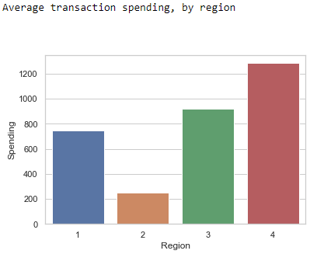
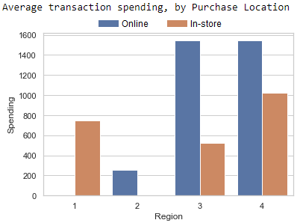
Customer Behavior
Spending Patterns Differ By Region
Regions
West spent the most at $1,284 per transaction.
$33.4 million (26,000 transactions)
South spent the least at $252 per transaction.
$5.04 million (20,000 transactions)
Online vs In-store
Similar online averages in East and West regions.
No online purchases by North region.
Highest in-store average in West region.
No in-store purchases by South region.
Notes:
Do customers in different regions spend more per transaction? Which regions spend the most/least?

Slide 6
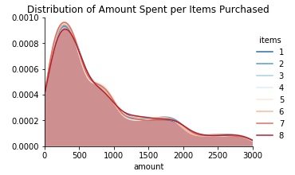
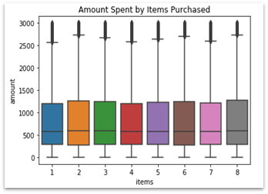
Customer Behavior
Relation Between Items Purchased and Amount Spent
No relation exist between items purchased and amount spent.
The average spending for each item group was approximately $830.
Notes:
Do customers in different regions spend more per transaction? Which regions spend the most/least?

Slide 7
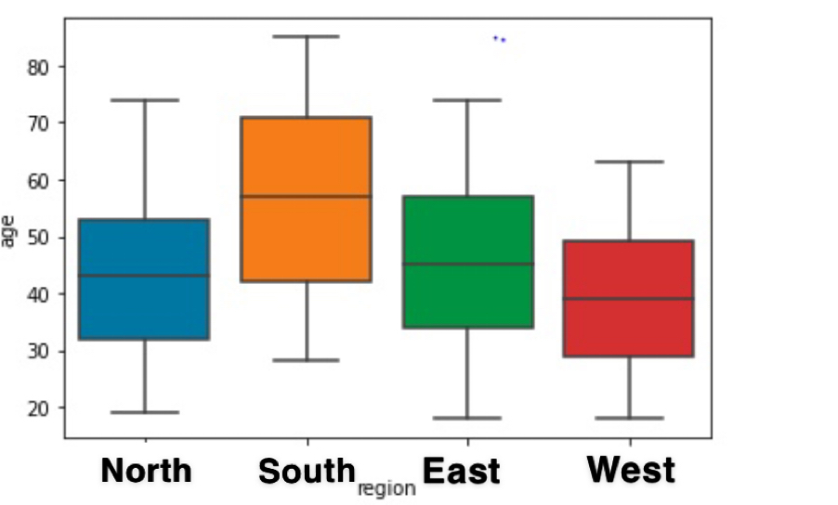
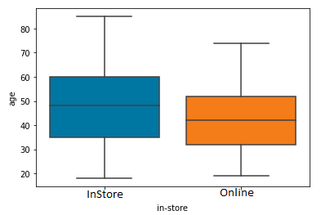
Customer Demographics
Predictability of customer age based on other demographic data
Age of a customer cannot be reliably predicted with other demographic data provided.
There is no correlation between the age of a customer and the region or mode of purchase.
Notes:
Is there any correlation between age of a customer and if the transaction was made online or in the store? Do any other factors predict if a customer will buy online or in our stores?

Slide 8
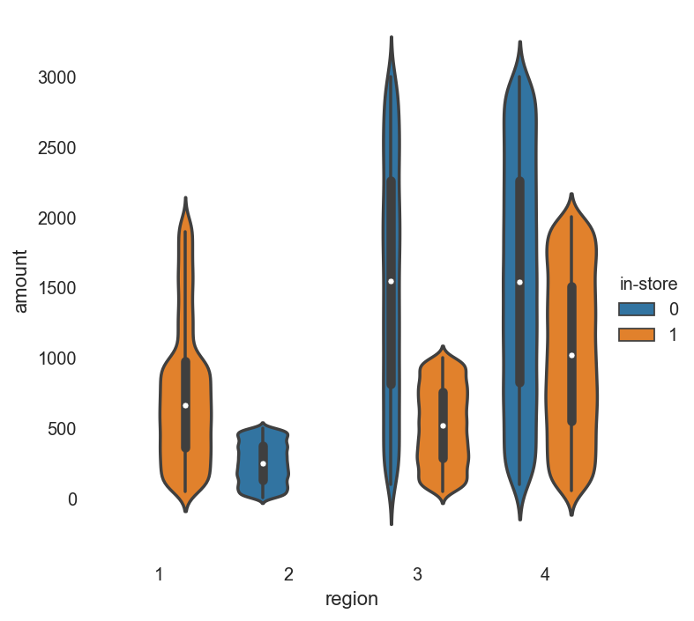
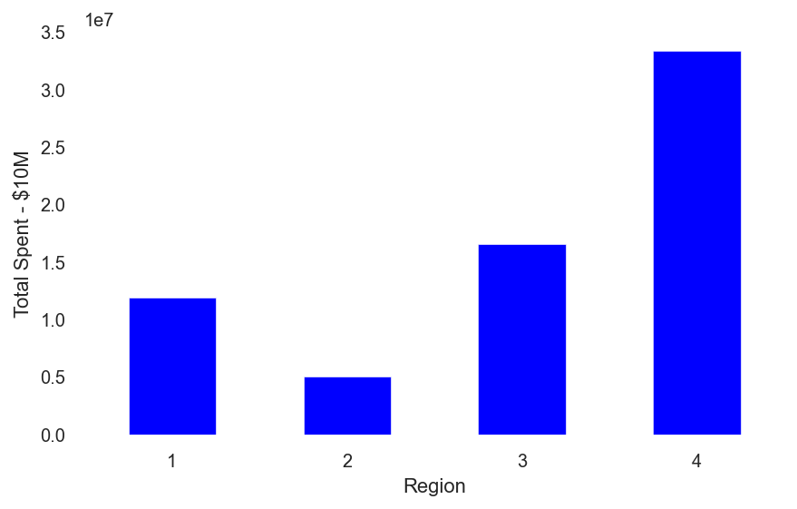
Data Driven Insights
Leverageable Relationships and Trends
Region is the most important variable for deciphering the purchasing habits of our customer base.
Leveraging the following 4 relationships, we can predict whether a purchase was in-store or online with ~86% accuracy:
All region 1 (N) purchases are in-store.
All region 2 (S) purchases are online.
All purchases over 2000 dollars have been online
Region 3 (E) had no online in store purchases over 1000 dollars.
We can leverage these insights to target specific customers, influence purchases, and/or capture untapped markets.

Slide 9
Data Driven Insights
Value Added: Invalidating Assumptions and Improving our Marketing Strategy
A Near Miss:
Previous Assumption: x Older people shop online x Older people spend more
Previous Proposed Strategy: x Marketing and website changes to attract older buyers
Pivoting to Win: We can now leverage real data driven insights and regional trends to improve our marketing strategies.
Several Strategy Ideas: $ Market to online shopping Region 1 (N) $ Investigate store value in Region 2 (S)
Future data mining work can be done to further develop or hone in on best strategy

Slide 10
Future Data Mining Applications
Future Applications
Single Customer View
Helps with targeted advertising
Increase Average Transaction Value
Dynamically understand products that are frequently purchased together
Streamlining Requirements
Streamline logistics
Requirements for future applications
Product Category
Introduce Loyalty Membership to create unique customer ID
Notes:
thinking about how we can leverage data mining in the future to make data-driven decisions about all aspects of our eBusiness
lists the types of questions data mining can help answer; one to two slides should be sufficient

Slide 11
Conclusions and next steps
Recommendations:
Retain or expand online advertising in East and West where amount spent is highest and online purchases are common.
Investigate stores in the South where 100% of sales are online and amount per purchase is lowest to move sales online and increase amount
Expand online marketing in the North to capture the purchase amount trends of the East and West.
Next Steps:
Conduct market study and consider store closure if sales in south remain online only
Focus on bringing sales in the North online to capture $2,000+ sales
Expand data collection for future data mining applications

Slide 12
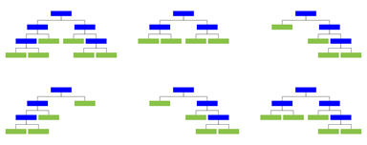
Random Forest
What is a Random Forest?
Collection of large number of individual decision trees that operate as an ensemble
Works on the concept of “the wisdom of crowds”
Key Features
Bagging (Bootstrap Aggregation)
Feature Randomness
Advantages
Improved accuracy
Works well with both categorical and continuous variables
Very stable
Disadvantages
Complexity
Longer Training Period
Notes:
https://towardsdatascience.com/understanding-random-forest-58381e0602d2

